Slide 1
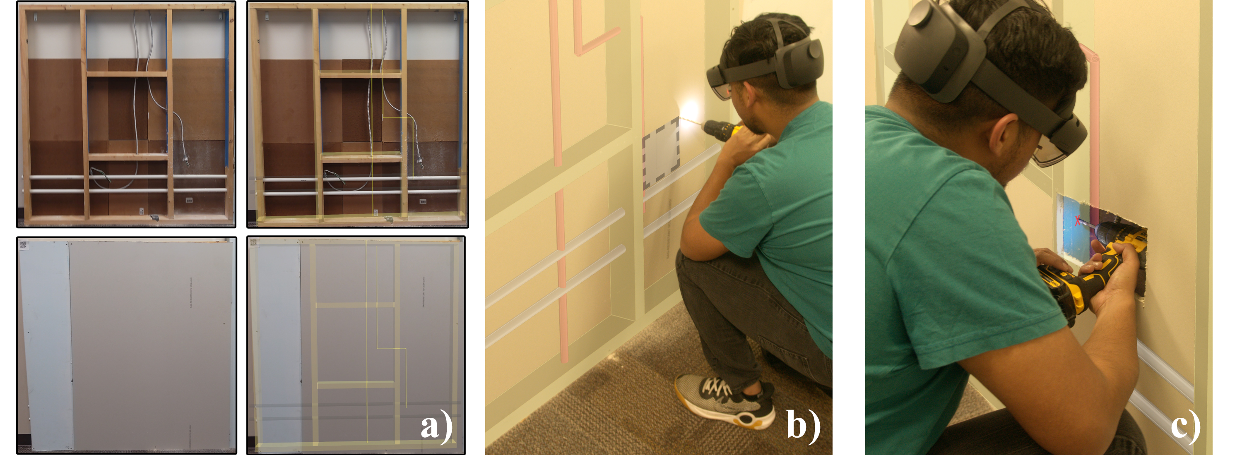
BIM-enabled AR Retrofit Training [WORKING TITLE]
ISMAR2023
Submission ID: 1015

Slide 2
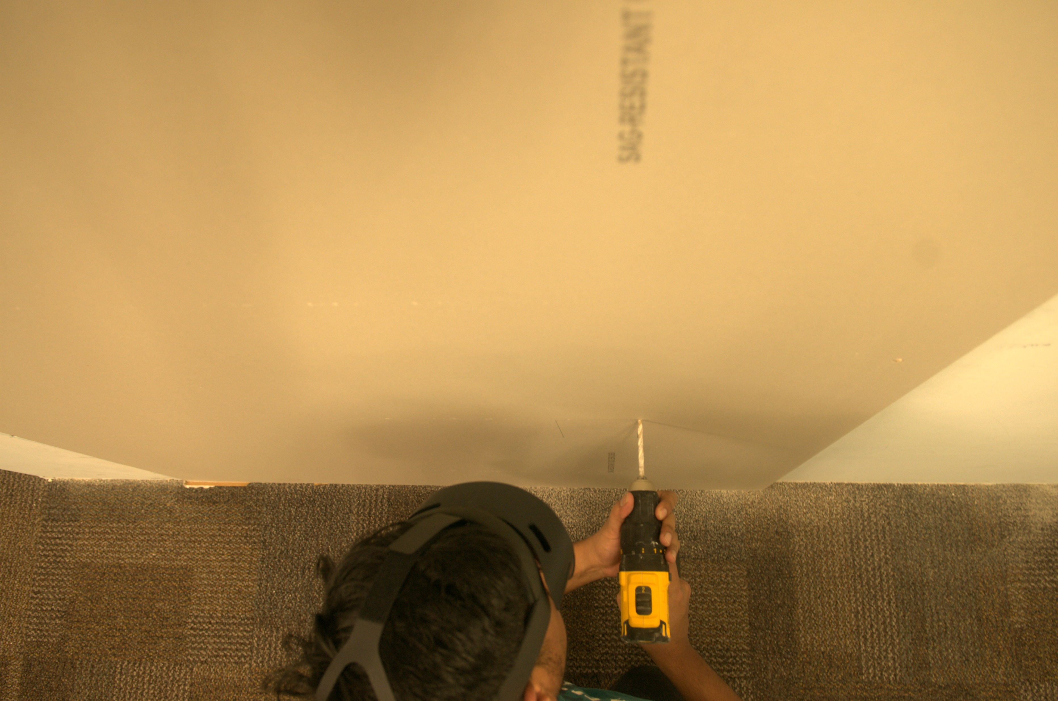
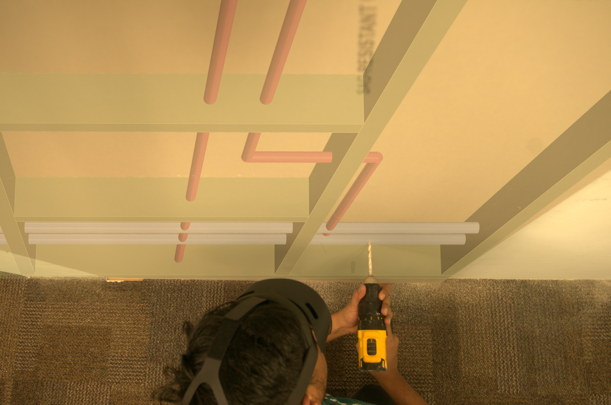

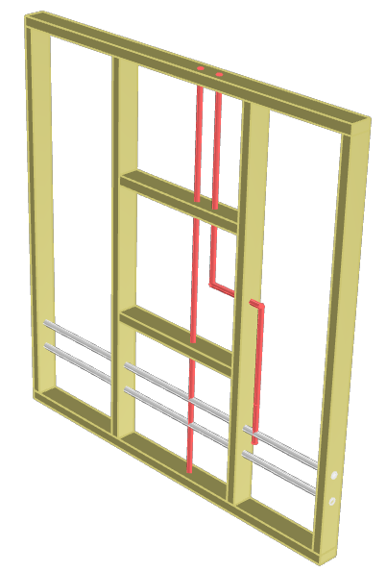

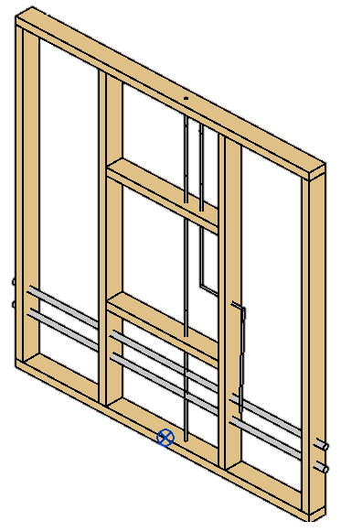
Retrofitting
Building Information Modeling
Augmented Reality
Augmenting and displaying BIM data during retrofitting training

Slide 3
Study Design
“What are they doing?”
Groups

Slide 4
AR-BIM Demonstration

Slide 5
Paper Demonstration

Slide 6
Measures
ffff

Slide 7
Hypotheses
ffff

Slide 8
Results and Discussion
ffff

Slide 9
Premise
Augmenting and displaying BIM data during retrofitting training
Retrofitting
Building Information Modeling
Augmented Reality

Slide 10
Premise
Augmenting and displaying BIM data during retrofitting training
Retrofitting
Building Information Modeling
Augmented Reality

